Slide 1
Logistic Regression Model to Predict Advertisement Clicks
Done by: Shivani
Rajyalakshmi
Bhavani

Slide 2
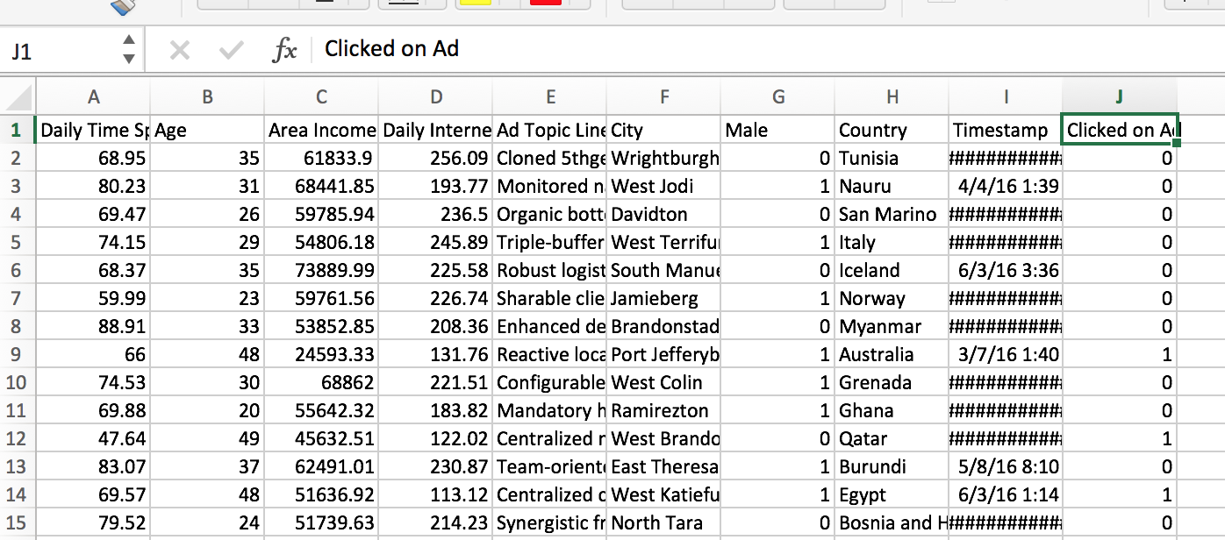
Data used for Project

Slide 3
Logistic Regression
Logistic Regression is a classification algorithm.
It is used to predict a binary outcome (1 / 0, Yes / No, True / False) of a categorical dependent variable, given a set of independent variables.
Hence the classification is called Binary classification.

Slide 4
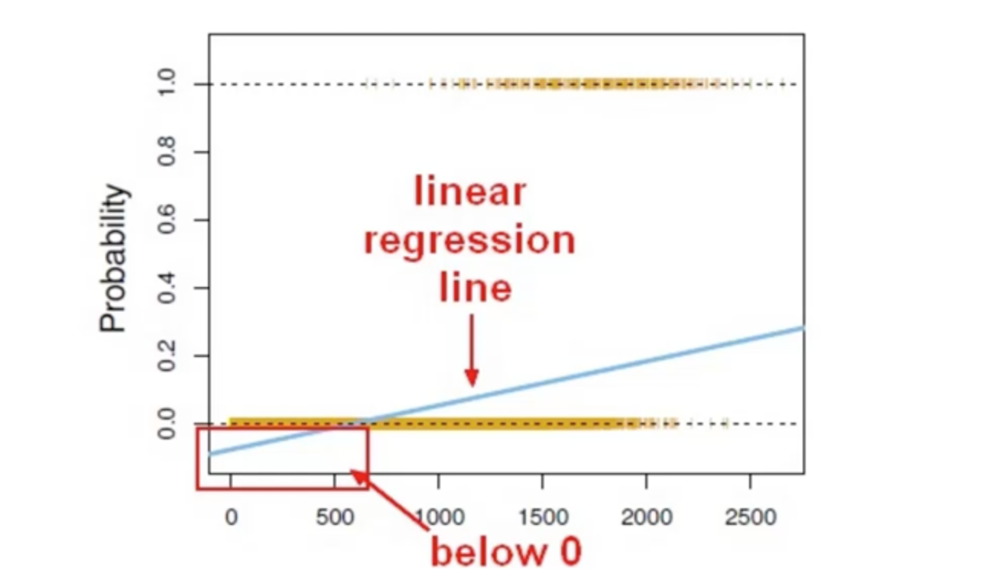
Binary Classification and Linear regression line

Slide 5
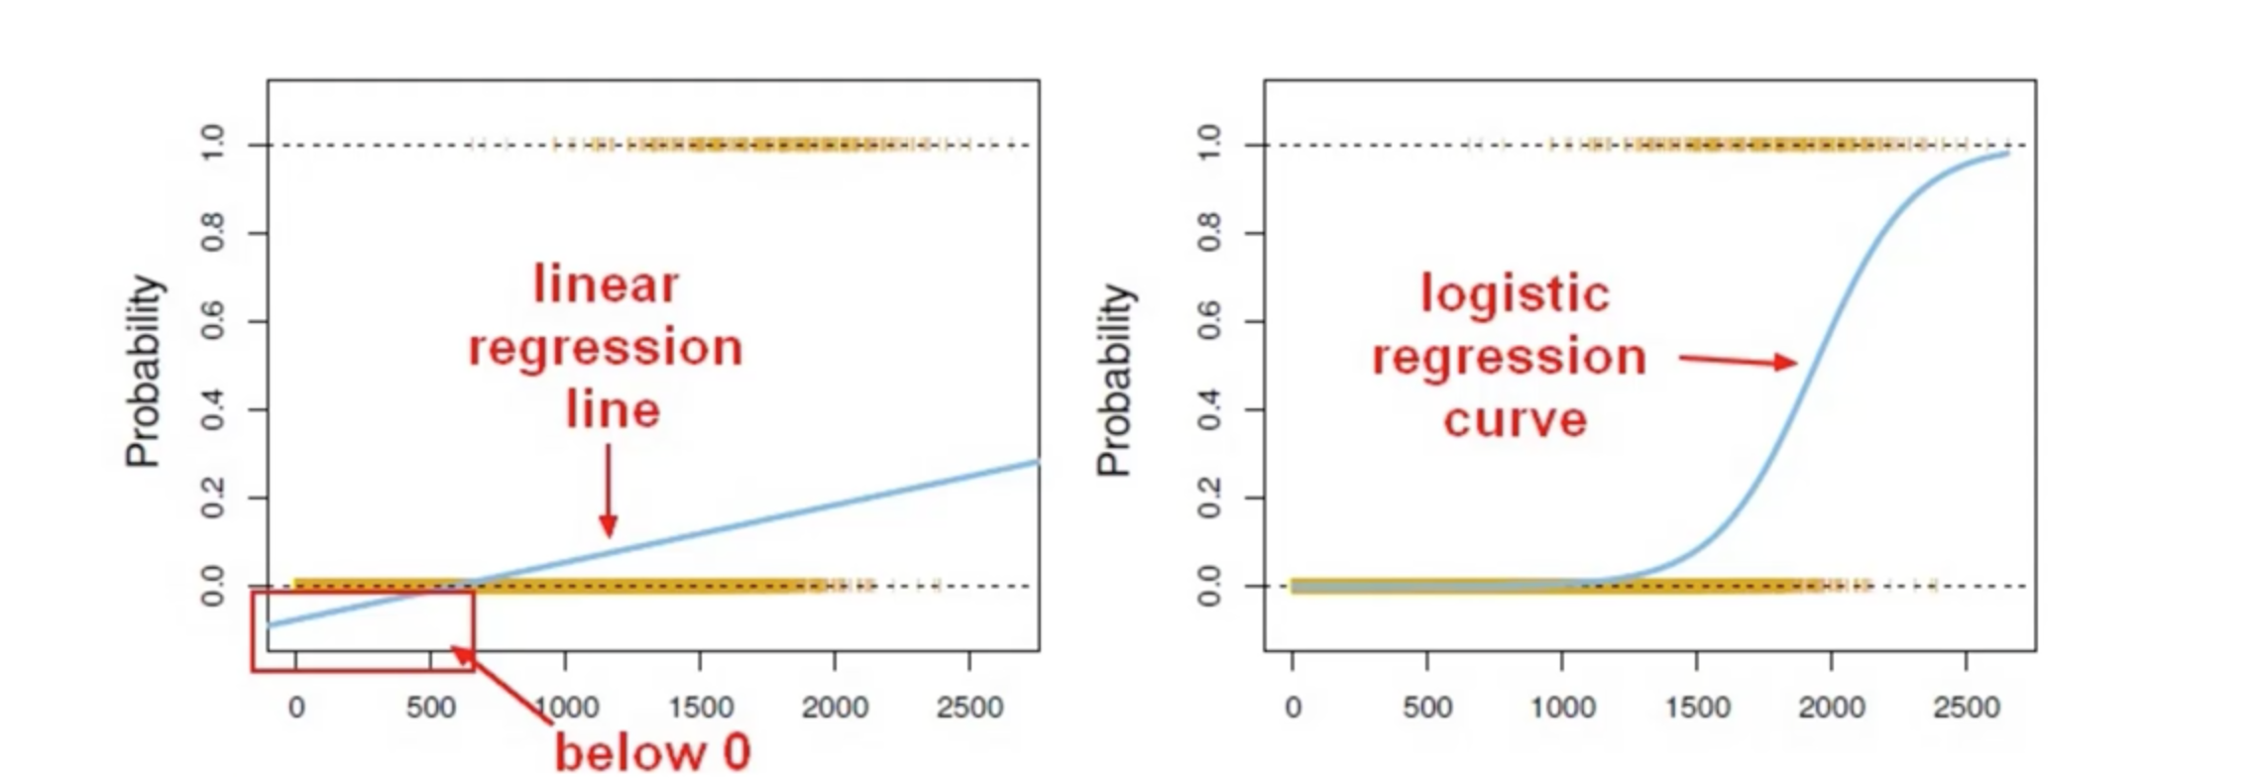
Linear regression line vs logistic regression curve

Slide 6
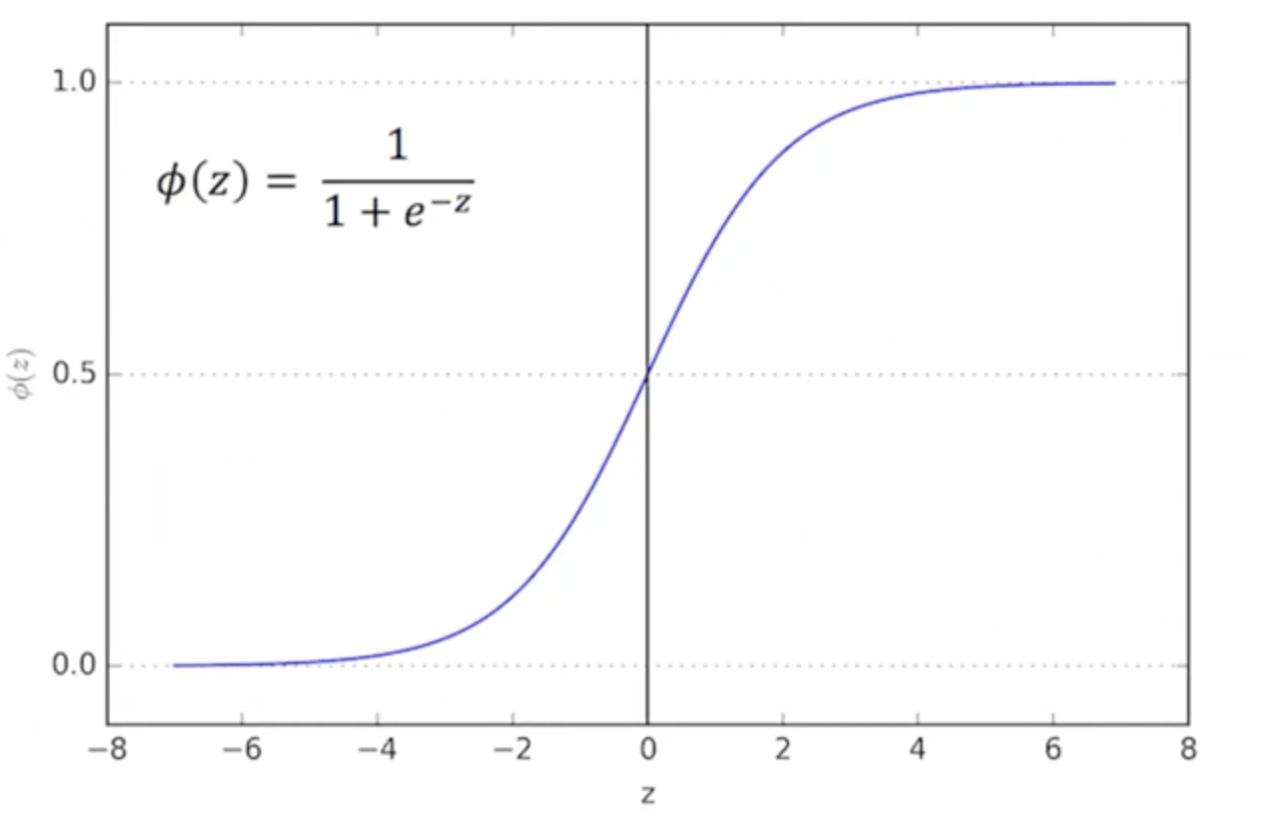
Sigmoid Function

Slide 7
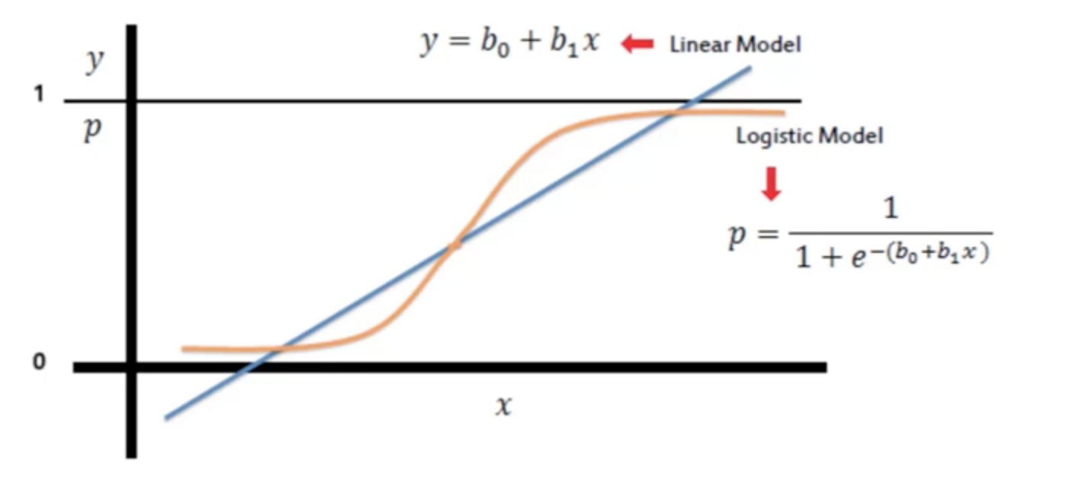
Sigmoid function

Slide 8
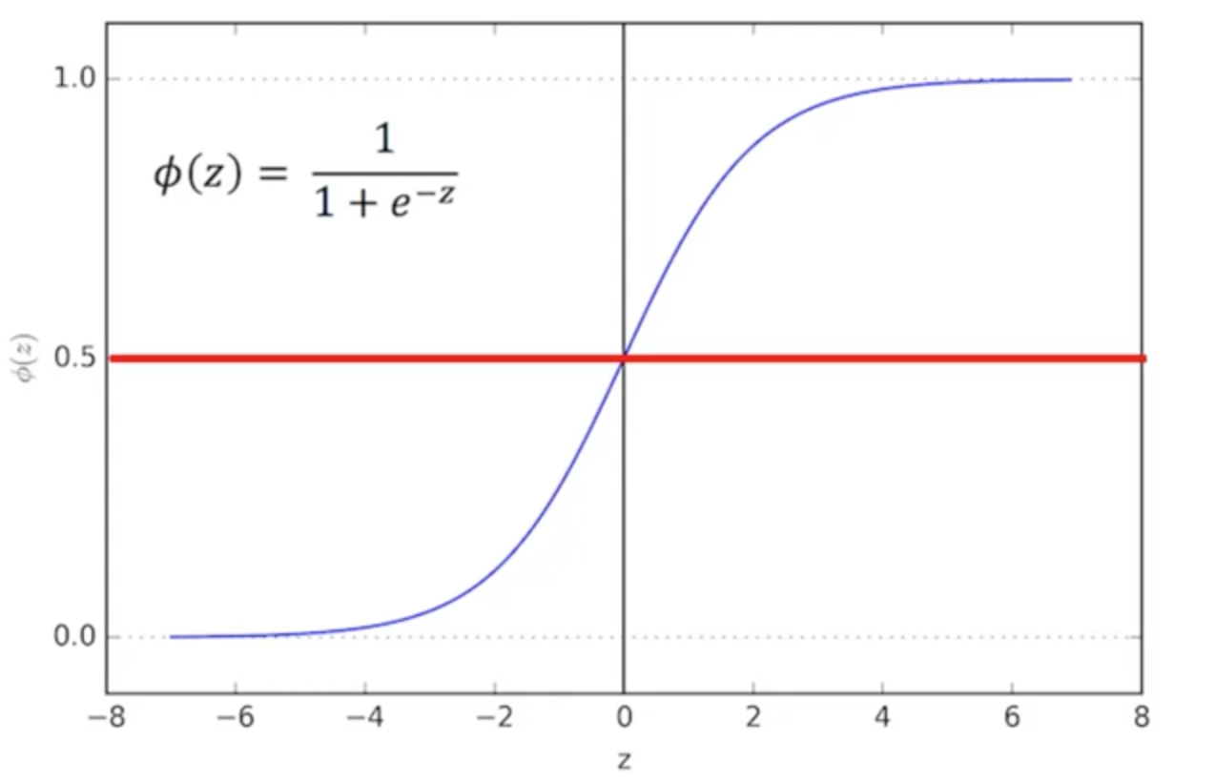
Sigmoid function- Cutoff point

Slide 9
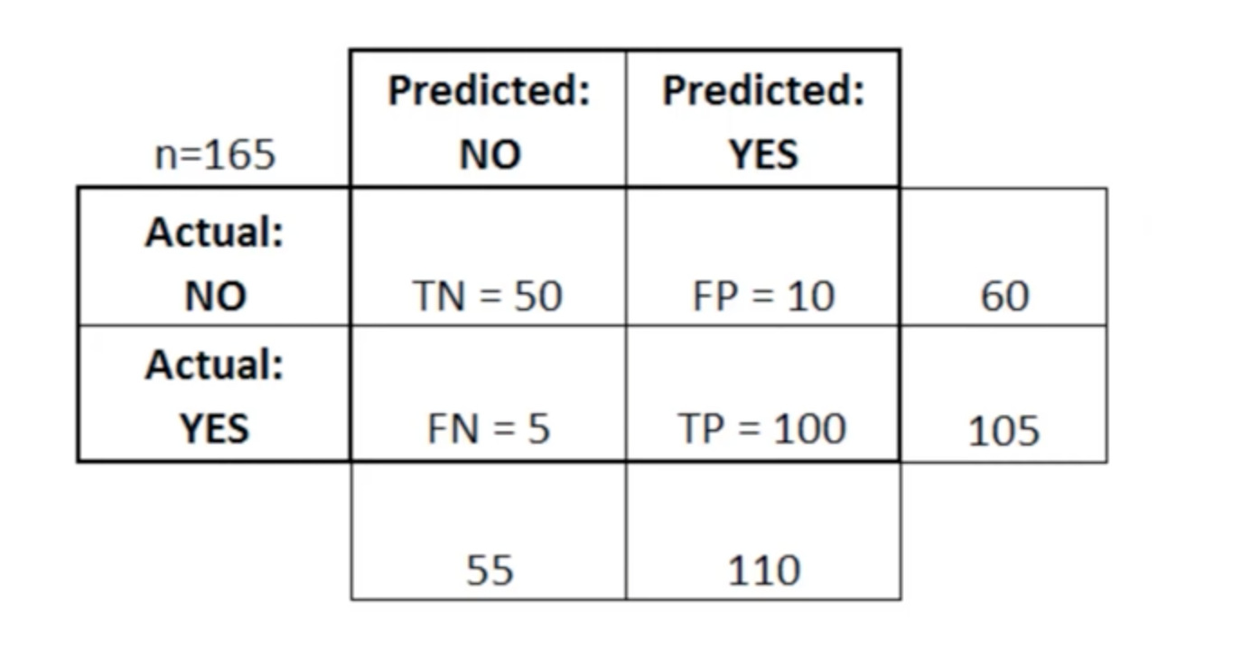
Confusion Matrix

Slide 10
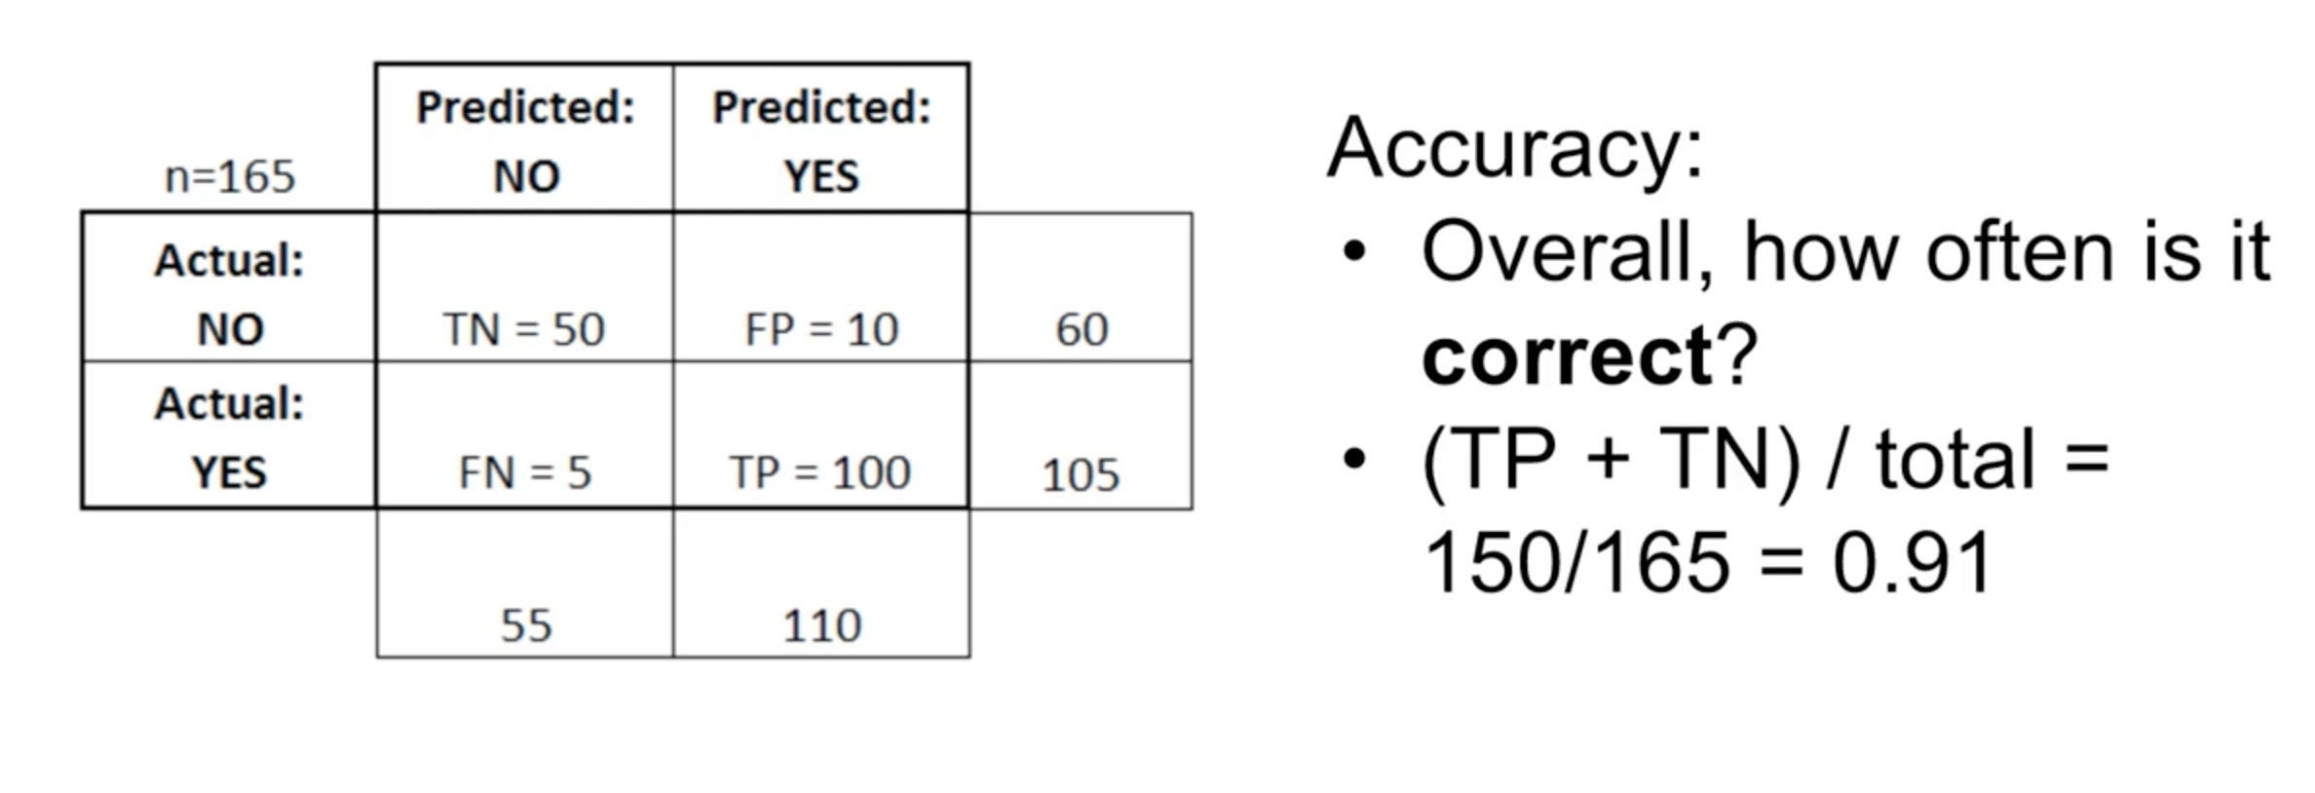
Confusion Matrix

Slide 11
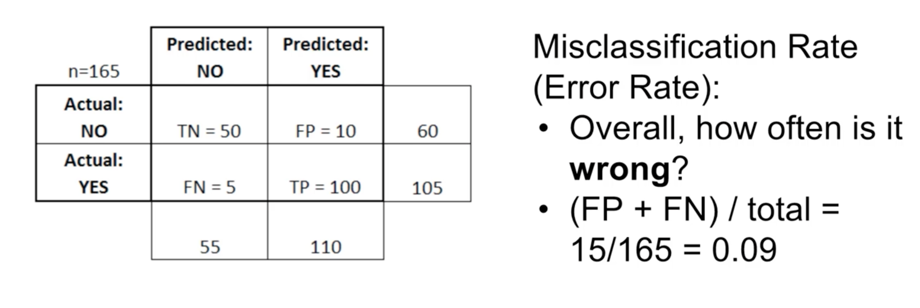
Confusion Matrix

